Slide 1

Chapter 8:
Decision Analysis
© 2007 Pearson Education

Slide 2
Decision Analysis
For evaluating and choosing among alternatives
Considers all the possible alternatives and possible outcomes

Slide 3
Five Steps in Decision Making
Clearly define the problem
List all possible alternatives
Identify all possible outcomes for each alternative
Identify the payoff for each alternative & outcome combination
Use a decision modeling technique to choose an alternative

Slide 4
Thompson Lumber Co. Example
Decision: Whether or not to make and sell storage sheds
Alternatives:
  Build a large plant
  Build a small plant
  Do nothing
Outcomes: Demand for sheds will be high, moderate, or low

Slide 5
Payoffs
Alternatives | Outcomes (Demand)
 | High | Moderate | Low
Large plant | 200,000 | 100,000 | -120,000
Small plant | 90,000 | 50,000 | -20,000
No plant | 0 | 0 | 0
Apply a decision modeling method

Slide 6
Types of Decision
Modeling Environments
Type 1: Decision making under certainty
Type 2: Decision making under uncertainty
Type 3: Decision making under risk

Slide 7
Decision Making Under Certainty
The consequence of every alternative is known
Usually there is only one outcome for each alternative
This seldom occurs in reality

Slide 8
Decision Making Under Uncertainty
Probabilities of the possible outcomes are not known
Decision making methods:
  Maximax
  Maximin
  Criterion of realism
  Equally likely
  Minimax regret

Slide 9
Maximax Criterion
The optimistic approach
Assume the best payoff will occur for each alternative
Alternatives | Outcomes (Demand)
 | High | Moderate | Low
Large plant | 200,000 | 100,000 | -120,000
Small plant | 90,000 | 50,000 | -20,000
No plant | 0 | 0 | 0
Choose the large plant (best payoff)

Slide 10
Maximin Criterion
The pessimistic approach
Assume the worst payoff will occur for each alternative
Alternatives | Outcomes (Demand)
 | High | Moderate | Low
Large plant | 200,000 | 100,000 | -120,000
Small plant | 90,000 | 50,000 | -20,000
No plant | 0 | 0 | 0
Choose no plant (best payoff)

Slide 11
Criterion of Realism
Uses the coefficient of realism (α) to estimate the decision maker’s optimism
0 < α < 1
α x (max payoff for alternative)
+ (1- α) x (min payoff for alternative)
= Realism payoff for alternative

Slide 12
Suppose α = 0.45
Choose small plant
Alternatives | Realism Payoff
Large plant | 24,000
Small plant | 29,500
No plant | 0

Slide 13
Equally Likely Criterion
Assumes all outcomes equally likely and uses the average payoff
Chose the large plant
Alternatives | Average Payoff
Large plant | 60,000
Small plant | 40,000
No plant | 0

Slide 14
Minimax Regret Criterion
Regret or opportunity loss measures much better we could have done
Regret = (best payoff) – (actual payoff)
Alternatives | Outcomes (Demand)
 | High | Moderate | Low
Large plant | 200,000 | 100,000 | -120,000
Small plant | 90,000 | 50,000 | -20,000
No plant | 0 | 0 | 0
The best payoff for each outcome is highlighted

Slide 15
Regret Values
Alternatives | Outcomes (Demand)
 | High | Moderate | Low
Large plant | 0 | 0 | 120,000
Small plant | 110,000 | 50,000 | 20,000
No plant | 200,000 | 100,000 | 0
Max Regret
120,000
110,000
200,000
We want to minimize the amount of regret we might experience, so chose small plant
Go to file 8-1.xls

Slide 16
Decision Making Under Risk
Where probabilities of outcomes are available
Expected Monetary Value (EMV) uses the probabilities to calculate the average payoff for each alternative
EMV (for alternative i) =
∑(probability of outcome) x (payoff of outcome)

Slide 17
Expected Monetary Value (EMV) Method
Alternatives | Outcomes (Demand)
 | High | Moderate | Low
Large plant | 200,000 | 100,000 | -120,000
Small plant | 90,000 | 50,000 | -20,000
No plant | 0 | 0 | 0
EMV
86,000
48,000
0
Probability of outcome | 0.3 | 0.5 | 0.2
Chose the large plant

Slide 18
Expected Opportunity Loss (EOL)
How much regret do we expect based on the probabilities?
EOL (for alternative i) =
∑(probability of outcome) x (regret of outcome)

Slide 19
Regret (Opportunity Loss) Values
Alternatives | Outcomes (Demand)
 | High | Moderate | Low
Large plant | 0 | 0 | 120,000
Small plant | 110,000 | 50,000 | 20,000
No plant | 200,000 | 100,000 | 0
EOL
24,000
62,000
110,000
Probability of outcome | 0.3 | 0.5 | 0.2
Chose the large plant

Slide 20
Perfect Information
Perfect Information would tell us with certainty which outcome is going to occur
Having perfect information before making a decision would allow choosing the best payoff for the outcome

Slide 21
Expected Value With
Perfect Information (EVwPI)
The expected payoff of having perfect information before making a decision
EVwPI = ∑ (probability of outcome)
x ( best payoff of outcome)

Slide 22
Expected Value of
Perfect Information (EVPI)
The amount by which perfect information would increase our expected payoff
Provides an upper bound on what to pay for additional information
EVPI = EVwPI – EMV
EVwPI = Expected value with perfect information
EMV = the best EMV without perfect information

Slide 23
Payoffs in blue would be chosen based on perfect information (knowing demand level)
Alternatives | Demand
 | High | Moderate | Low
Large plant | 200,000 | 100,000 | -120,000
Small plant | 90,000 | 50,000 | -20,000
No plant | 0 | 0 | 0
Probability | 0.3 | 0.5 | 0.2
EVwPI = $110,000

Slide 24
Expected Value of Perfect Information
EVPI = EVwPI – EMV
= $110,000 - $86,000 = $24,000
The “perfect information” increases the expected value by $24,000
Would it be worth $30,000 to obtain this perfect information for demand?

Slide 25
Decision Trees
Can be used instead of a table to show alternatives, outcomes, and payofffs
Consists of nodes and arcs
Shows the order of decisions and outcomes

Slide 26
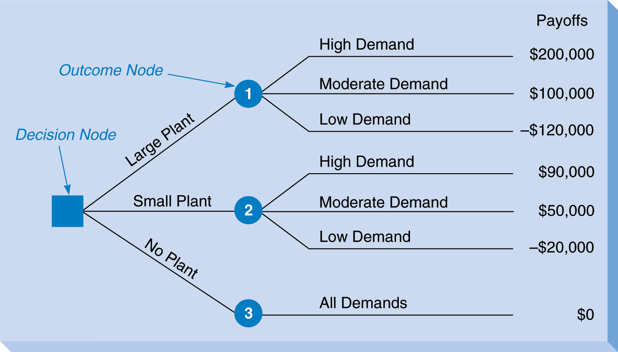
Decision Tree for Thompson Lumber

Slide 27
Folding Back a Decision Tree
For identifying the best decision in the tree
Work from right to left
Calculate the expected payoff at each outcome node
Choose the best alternative at each decision node (based on expected payoff)

Slide 28
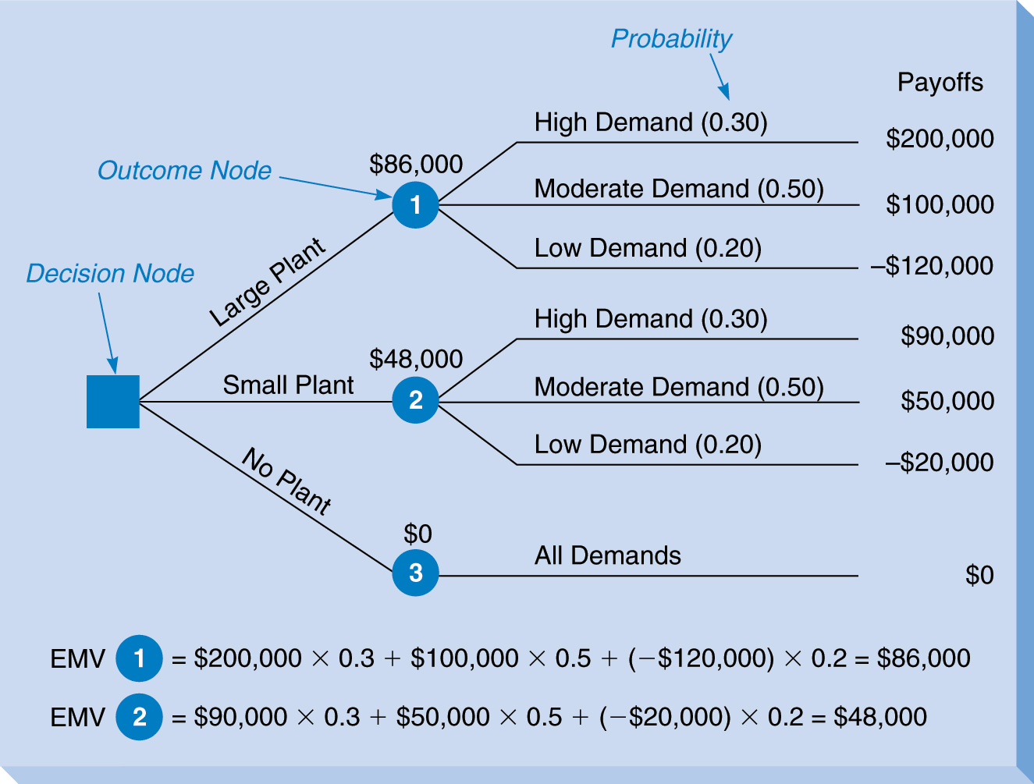
Thompson Lumber Tree with EMV’s

Slide 29
Using TreePlan With Excel
An add-in for Excel to create and solve decision trees
Load the file Treeplan.xla into Excel
(from the CD-ROM)

Slide 30
Decision Trees for Multistage Decision-Making Problems
Multistage problems involve a sequence of several decisions and outcomes
It is possible for a decision to be immediately followed by another decision
Decision trees are best for showing the sequential arrangement

Slide 31
Expanded Thompson
Lumber Example
Suppose they will first decide whether to pay $4000 to conduct a market survey
Survey results will be imperfect
Then they will decide whether to build a large plant, small plant, or no plant
Then they will find out what the outcome and payoff are

Slide 32
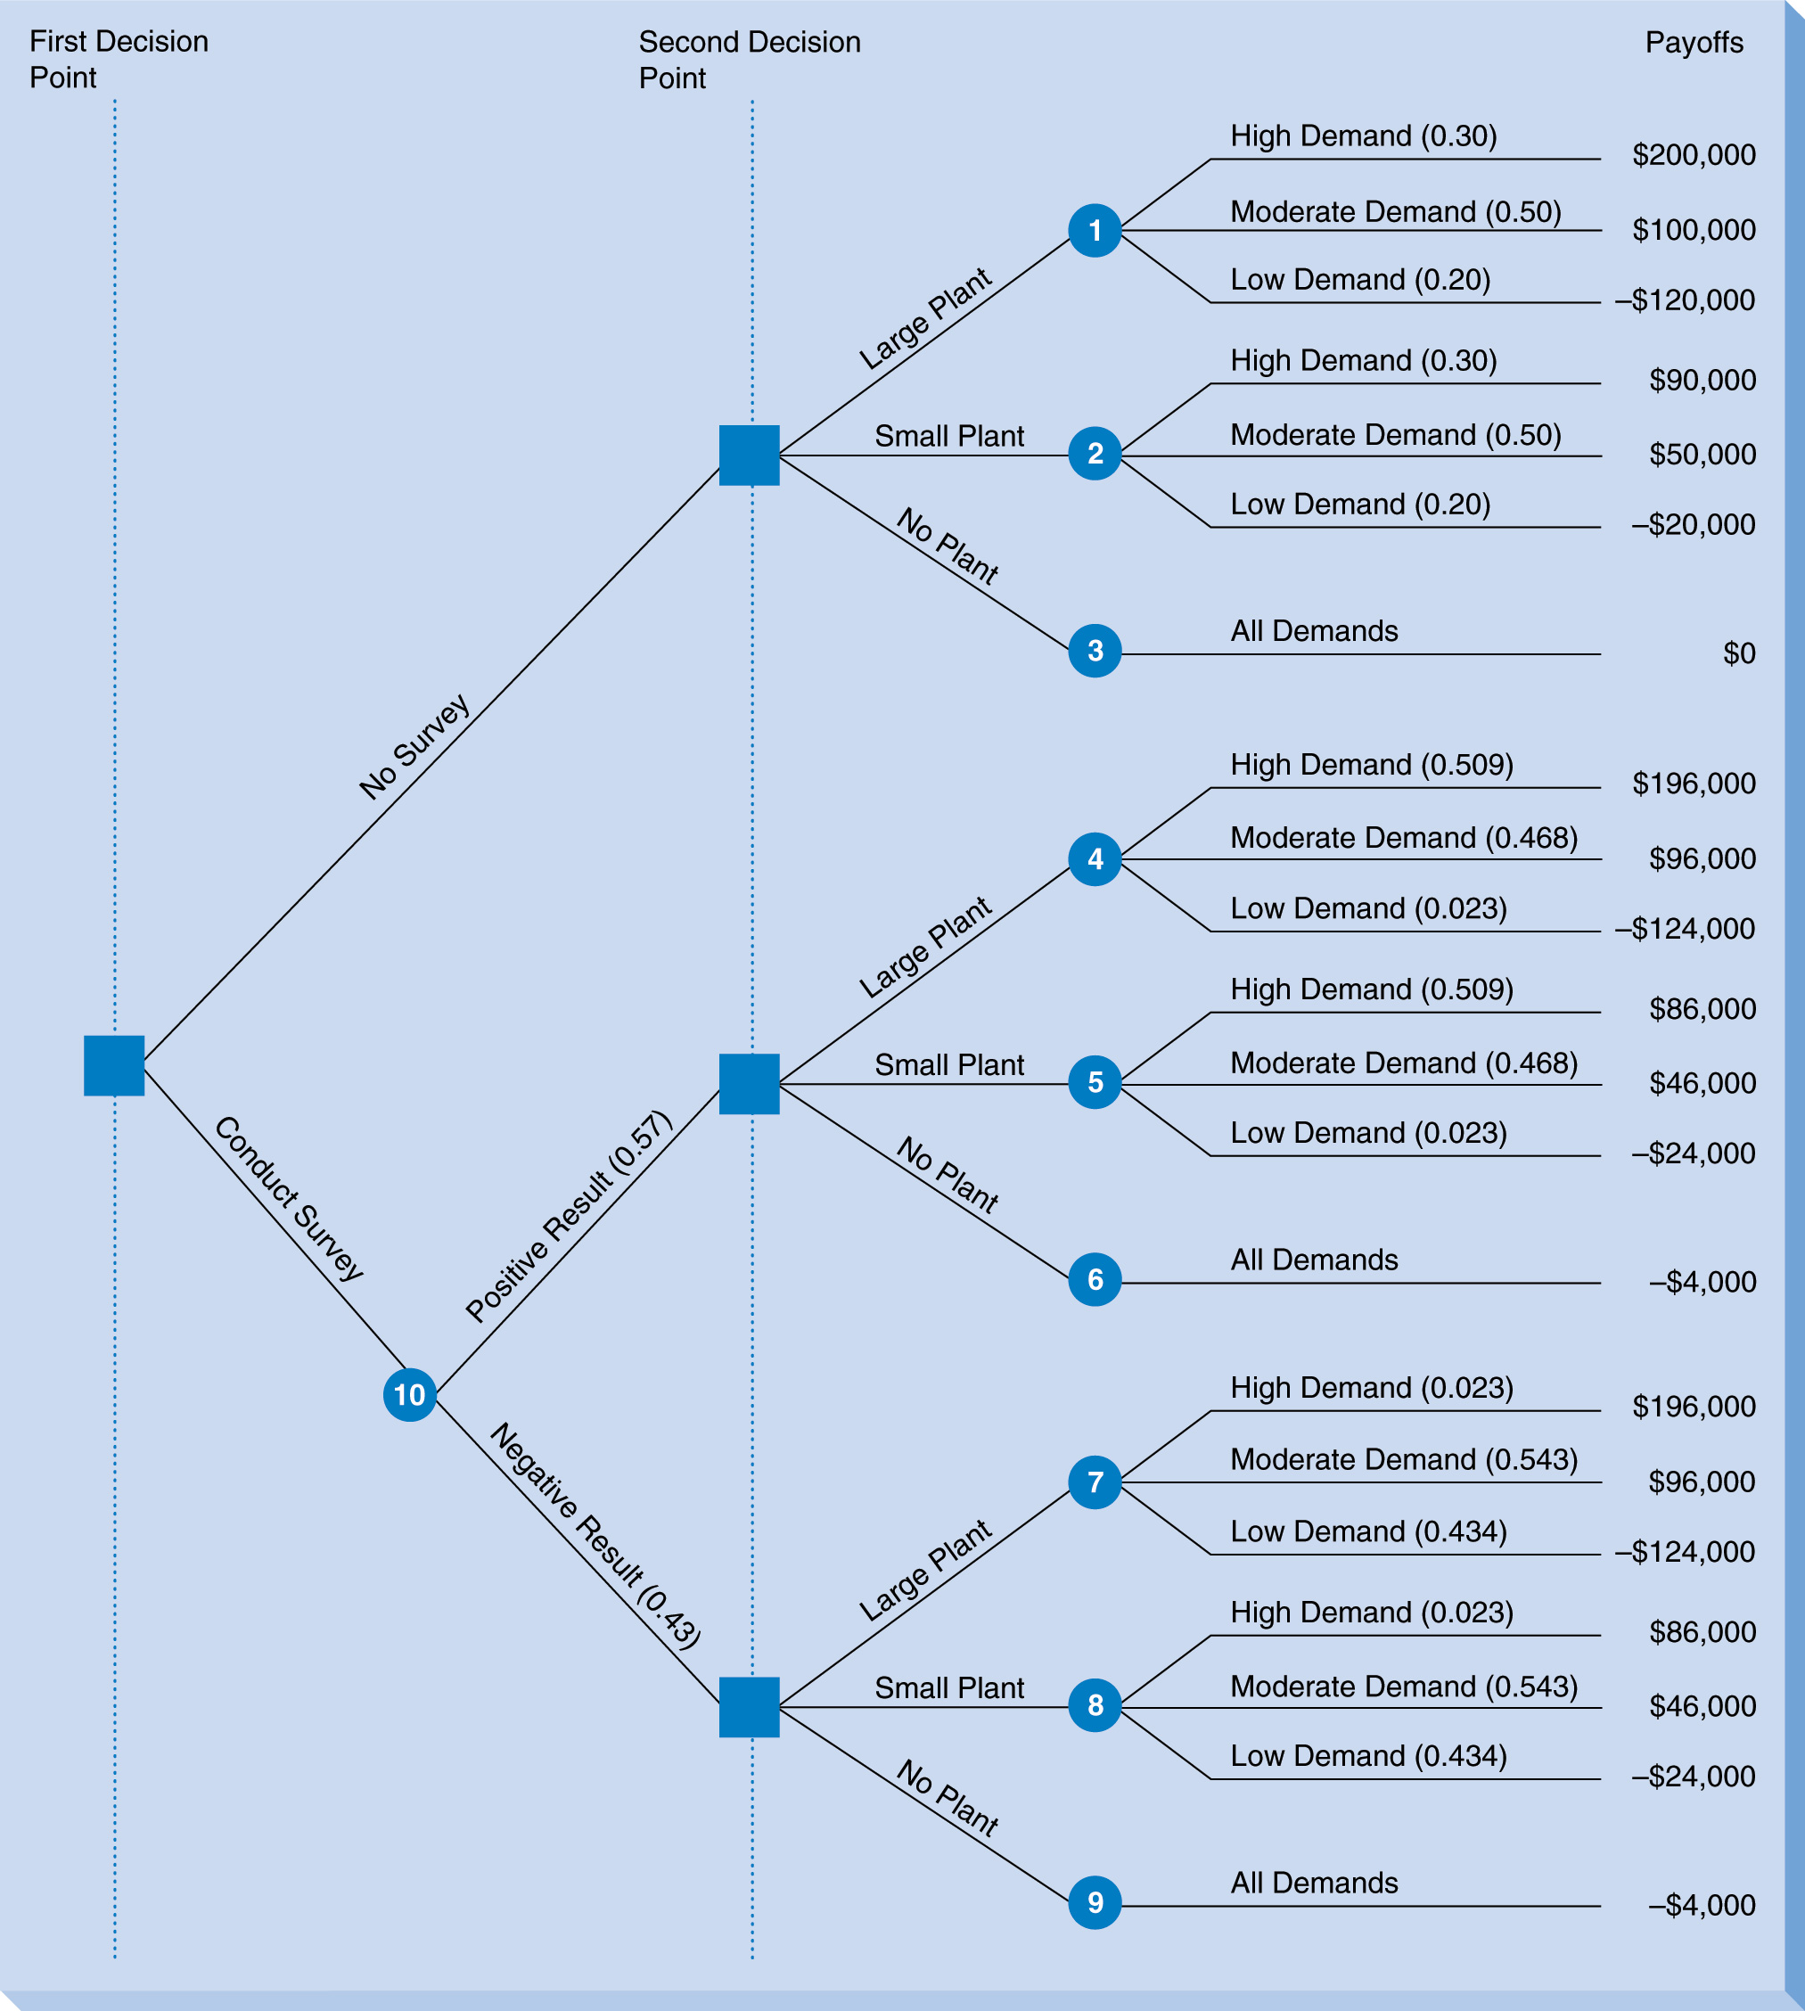

Slide 33
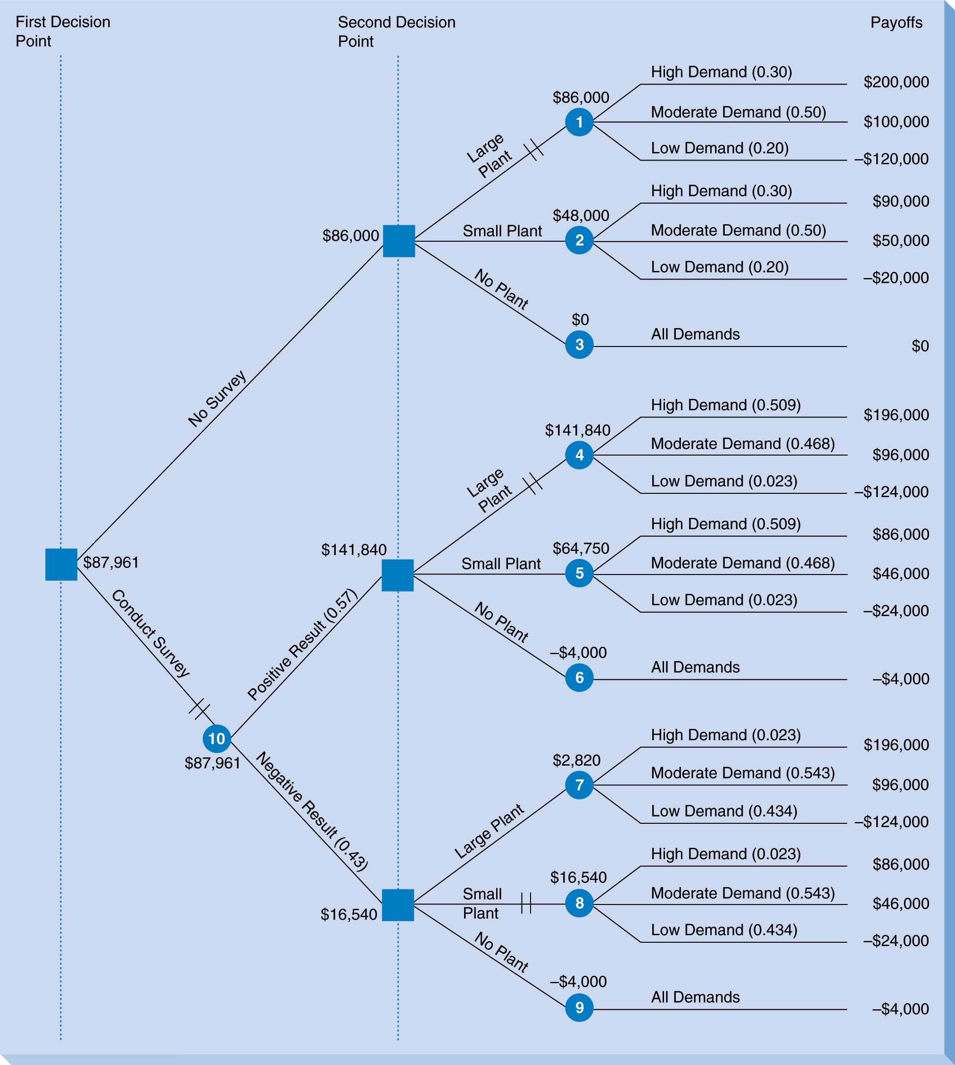

Slide 34
Thompson Lumber
Optimal Strategy
Conduct the survey
If the survey results are positive, then build the large plant (EMV = $141,840)
If the survey results are negative, then build the small plant (EMV = $16,540)

Slide 35
Expected Value of
Sample Information (EVSI)
The Thompson Lumber survey provides sample information (not perfect information)
What is the value of this sample information?
EVSI = (EMV with free sample information)
- (EMV w/o any information)

Slide 36
EVSI for Thompson Lumber
If sample information had been free
EMV (with free SI) = 87,961 + 4000 = $91,961
EVSI = 91,961 – 86,000 = $5,961

Slide 37
EVSI vs. EVPI
How close does the sample information come to perfect information?
Efficiency of sample information = EVSI
EVPI
Thompson Lumber: 5961 / 24,000 = 0.248

Slide 38
Estimating Probability
Using Bayesian Analysis
Allows probability values to be revised based on new information (from a survey or test market)
Prior probabilities are the probability values before new information
Revised probabilities are obtained by combining the prior probabilities with the new information

Slide 39
Known Prior Probabilities
P(HD) = 0.30
P(MD) = 0.50
P(LD) = 0.30
How do we find the revised probabilities where the survey result is given?
For example: P(HD|PS) = ?

Slide 40
It is necessary to understand the Conditional probability formula:
P(A|B) = P(A and B)
P(B)
P(A|B) is the probability of event A occurring, given that event B has occurred
When P(A|B) ≠ P(A), this means the probability of event A has been revised based on the fact that event B has occurred

Slide 41
The marketing research firm provided the following probabilities based on its track record of survey accuracy:
P(PS|HD) = 0.967 P(NS|HD) = 0.033
P(PS|MD) = 0.533 P(NS|MD) = 0.467
P(PS|LD) = 0.067 P(NS|LD) = 0.933
Here the demand is “given,” but we need to reverse the events so the survey result is “given”

Slide 42
Finding probability of the demand outcome given the survey result:
P(HD|PS) = P(HD and PS) = P(PS|HD) x P(HD)
P(PS) P(PS)
Known probability values are in blue, so need to find P(PS)
P(PS|HD) x P(HD) 0.967 x 0.30
+ P(PS|MD) x P(MD) + 0.533 x 0.50
+ P(PS|LD) x P(LD) + 0.067 x 0.20
= P(PS) = 0.57

Slide 43
Now we can calculate P(HD|PS):
P(HD|PS) = P(PS|HD) x P(HD) = 0.967 x 0.30
P(PS) 0.57
= 0.509
The other five conditional probabilities are found in the same manner
Notice that the probability of HD increased from 0.30 to 0.509 given the positive survey result

Slide 44
Utility Theory
An alternative to EMV
People view risk and money differently, so EMV is not always the best criterion
Utility theory incorporates a person’s attitude toward risk
A utility function converts a person’s attitude toward money and risk into a number between 0 and 1

Slide 45
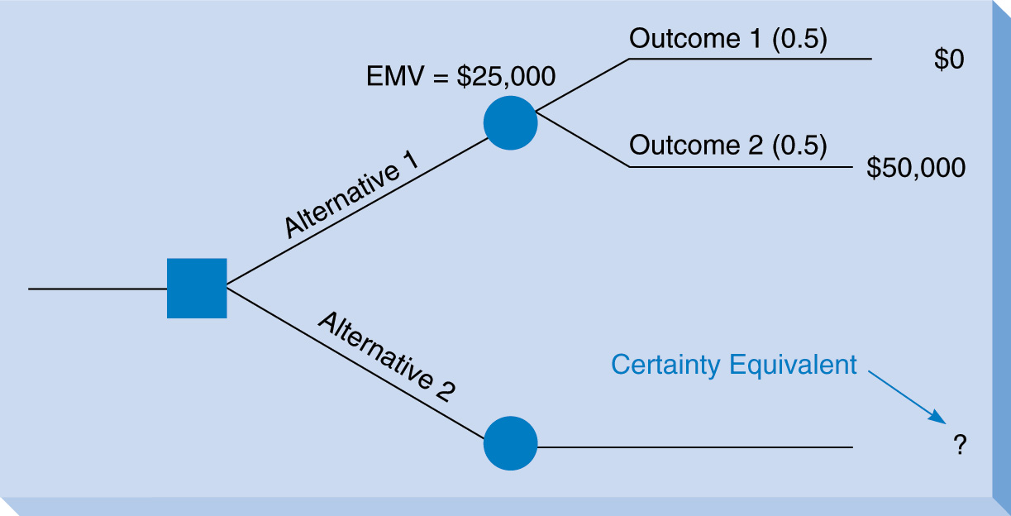
Jane’s Utility Assessment
Jane is asked: What is the minimum amount that would cause you to choose alternative 2?

Slide 46
Suppose Jane says $15,000
Jane would rather have the certainty of getting $15,000 rather the possibility of getting $50,000
Utility calculation:
U($15,000) = U($0) x 0.5 + U($50,000) x 0.5
Where, U($0) = U(worst payoff) = 0
U($50,000) = U(best payoff) = 1
U($15,000) = 0 x 0.5 + 1 x 0.5 = 0.5 (for Jane)

Slide 47
The same gamble is presented to Jane multiple times with various values for the two payoffs
Each time Jane chooses her minimum certainty equivalent and her utility value is calculated
A utility curve plots these values

Slide 48
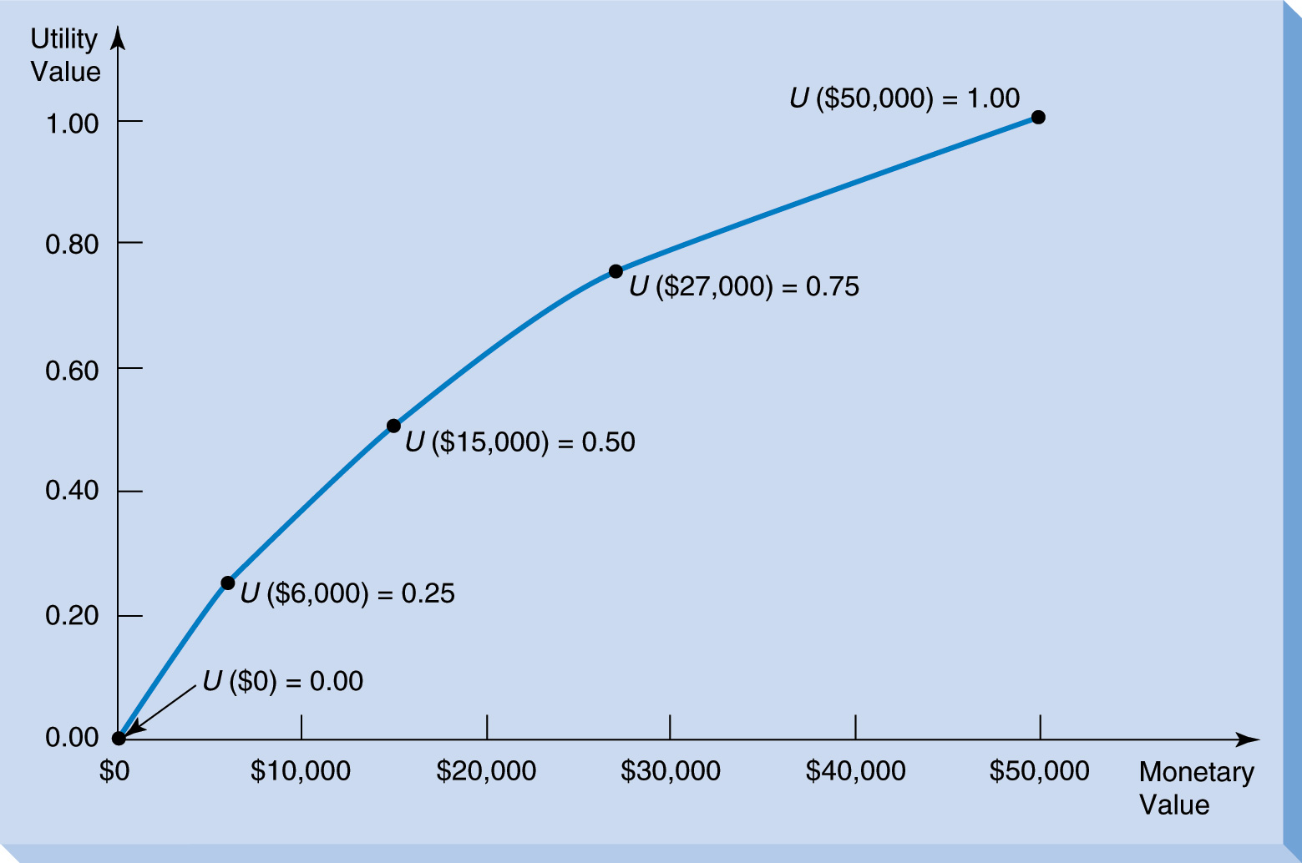
Jane’s Utility Curve

Slide 49
Different people will have different curves
Jane’s curve is typical of a risk avoider
Risk premium is the EMV a person is willing to willing to give up to avoid the risk
Risk premium = (EMV of gamble)
– (Certainty equivalent)
Jane’s risk premium = $25,000 - $15,000
= $10,000

Slide 50
Types of Decision Makers
Risk Premium
Risk avoiders: > 0
Risk neutral people: = 0
Risk seekers: < 0

Slide 51
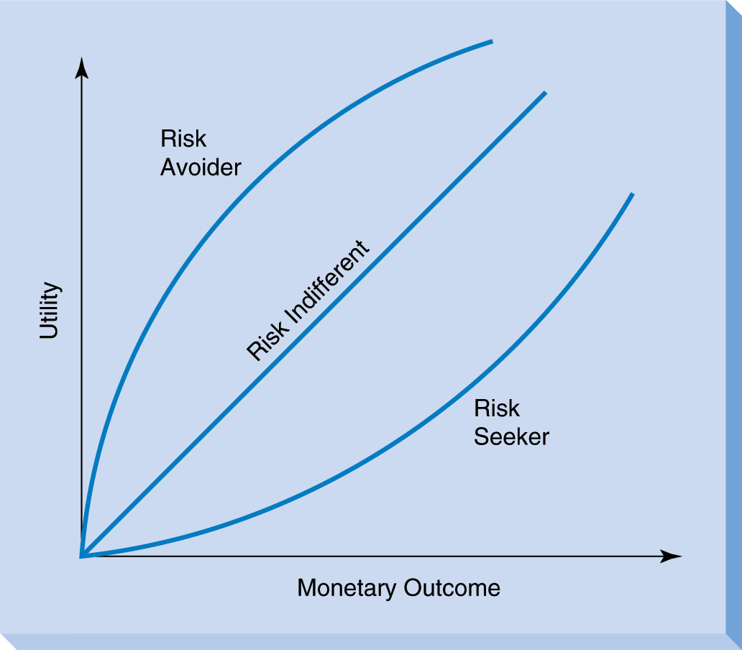
Utility Curves for Different Risk Preferences

Slide 52
Utility as a
Decision Making Criterion
Construct the decision tree as usual with the same alternative, outcomes, and probabilities
Utility values replace monetary values
Fold back as usual calculating expected utility values

Slide 53
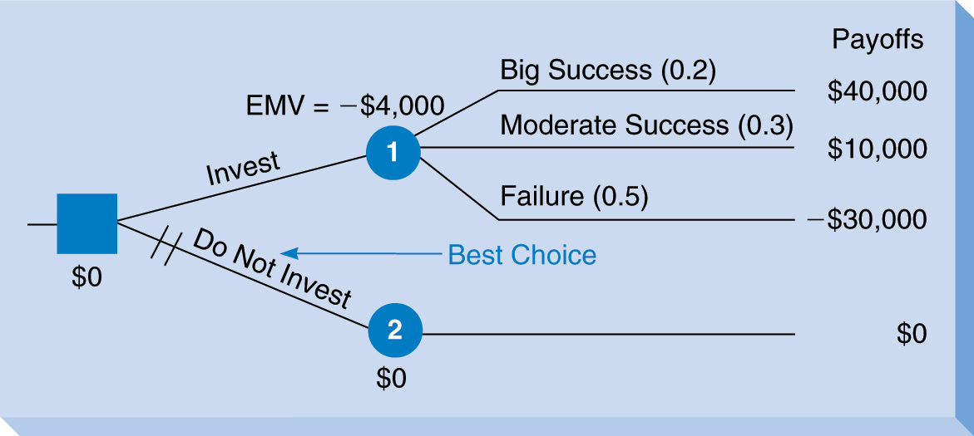
Decision Tree Example for Mark

Slide 54
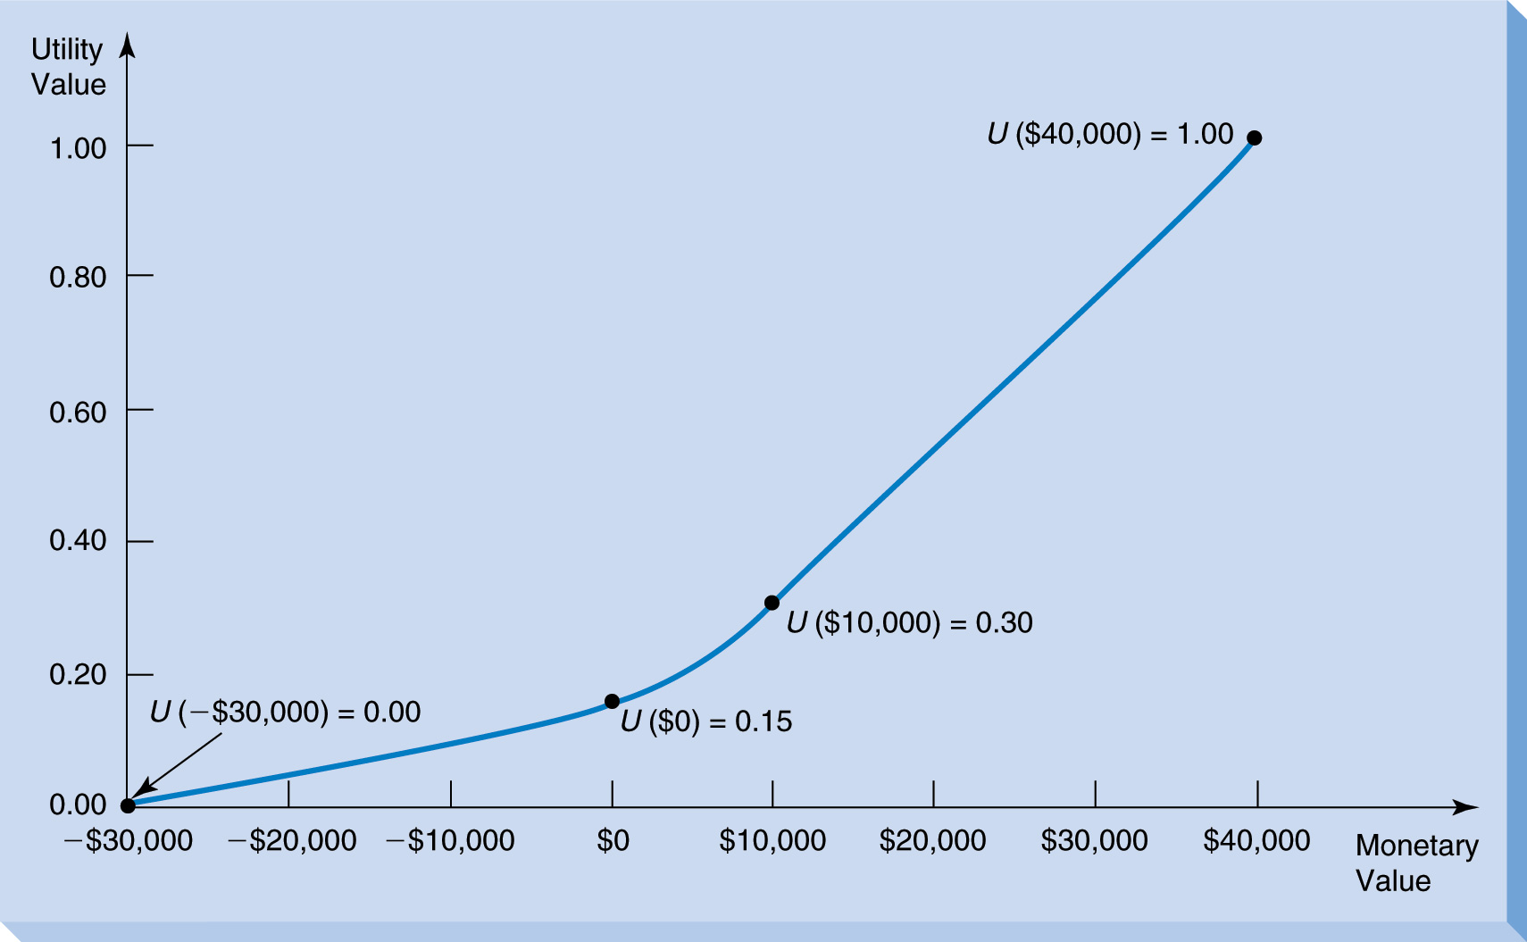
Utility Curve for Mark the Risk Seeker

Slide 55
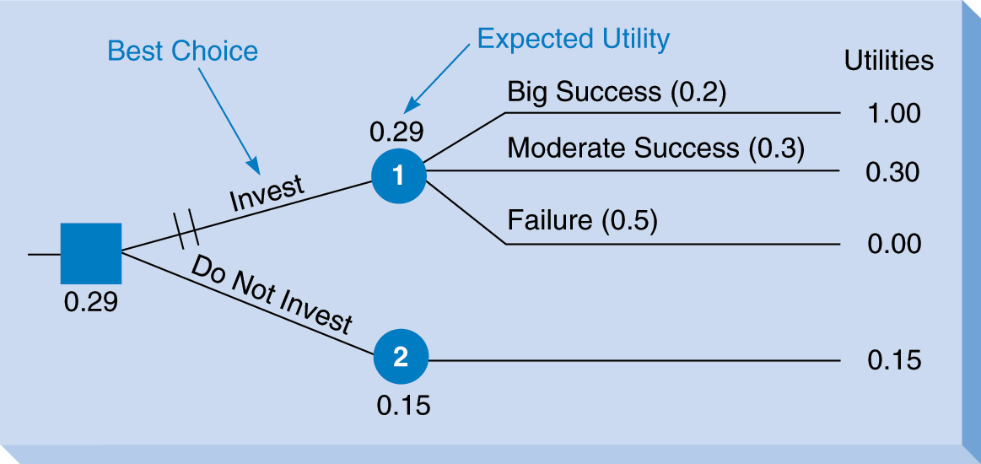
Mark’s Decision Tree With Utility Values

